Slide 1


Slide 2

Introduction
The Gym Membership Management System is a Java-based application that helps gyms efficiently manage member information, membership plans, and plan assignments.
Built using:
Java for core logic
JDBC for database connectivity
MySQL for storing records

Slide 3

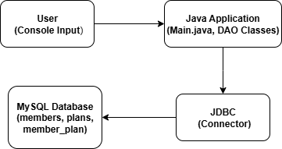
System Architecture

Slide 4

Modules
The Gym Membership Management System consists of the following key modules:
1. Add Member
- Collects member details: name, age, gender, phone, email
- Stores the data in the members table using JDBC and SQL INSERT
2. Add Membership Plan
-Takes input like plan name, duration (in months), and price
-Saves to the membership_plans table via SQL INSERT
3. Assign Plan to Member
-Displays all existing members and plans
-Assigns a selected plan to a member with a start date
-Stores relation in the member_plan table using SQL INSERT

Slide 5

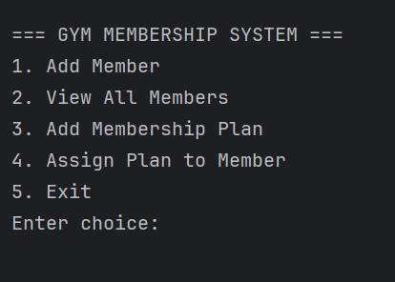
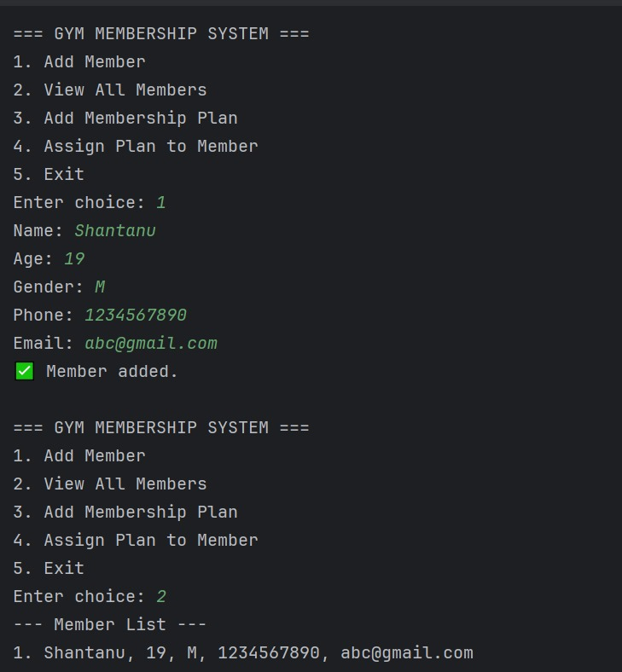
Output

Slide 6
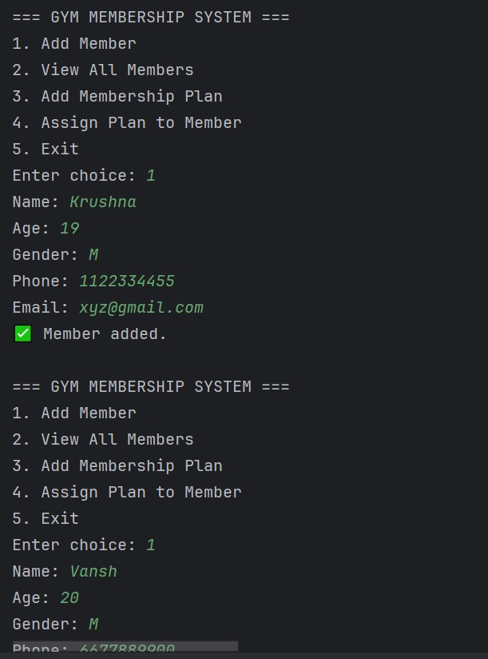
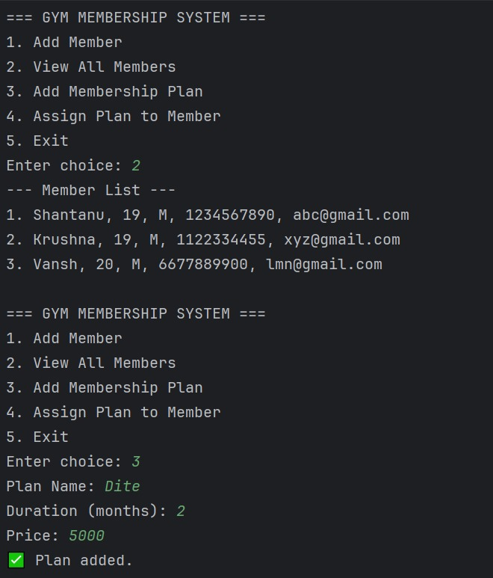

Slide 7
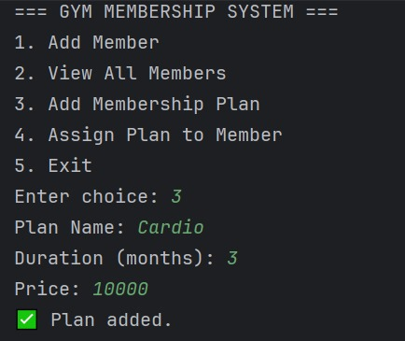
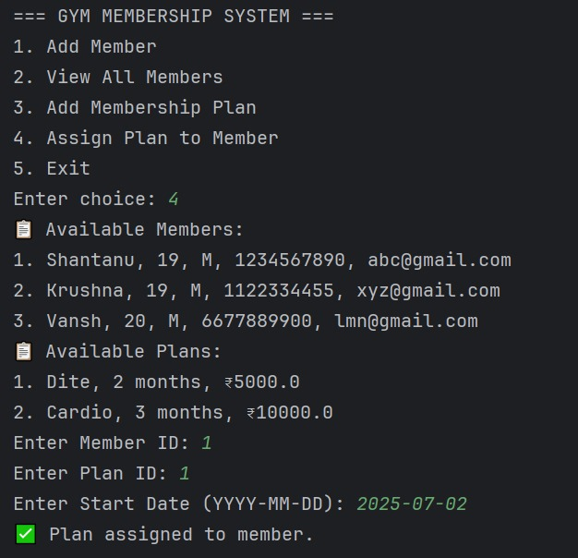

Slide 8
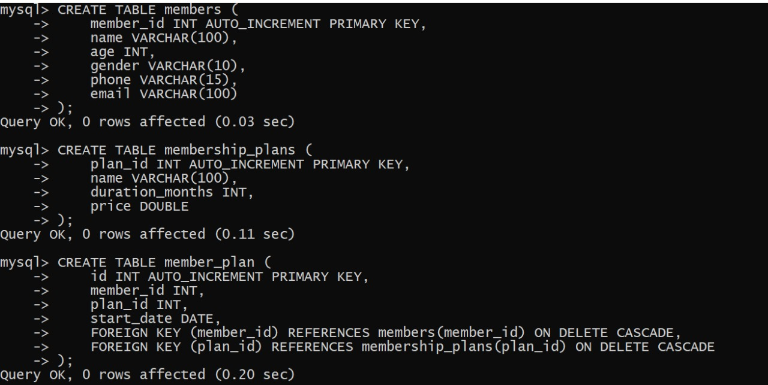
MYSQL Output

Slide 9
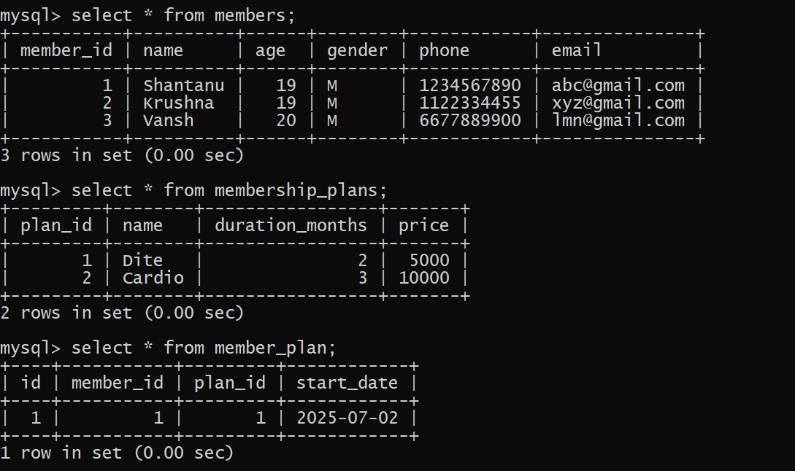

Slide 10
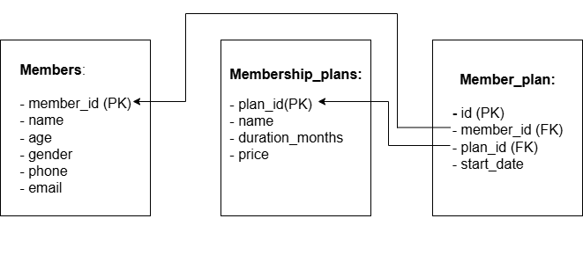
ER Diagram

Slide 11
Technologies Used
The project was developed using the following technologies:
Java – for core programming and logic
JDBC – for database connectivity
MySQL – for relational data storage
IntelliJ IDEA – as the development environment
SQL – for queries and table management

Slide 12

Conclusion
The Gym Membership Management System successfully demonstrates how a Java application can interact with a relational database using JDBC.
Through this system, we have:
Streamlined the management of gym members and plans
Implemented real-world database connectivity using JDBC
Designed a clean, modular codebase using object-oriented principles
This project enhances understanding of both backend development and database interaction — making it an excellent foundation for more advanced applications.

Slide 13


